Slide 1
Level 1 Task 2
Raviraj mane

Slide 2
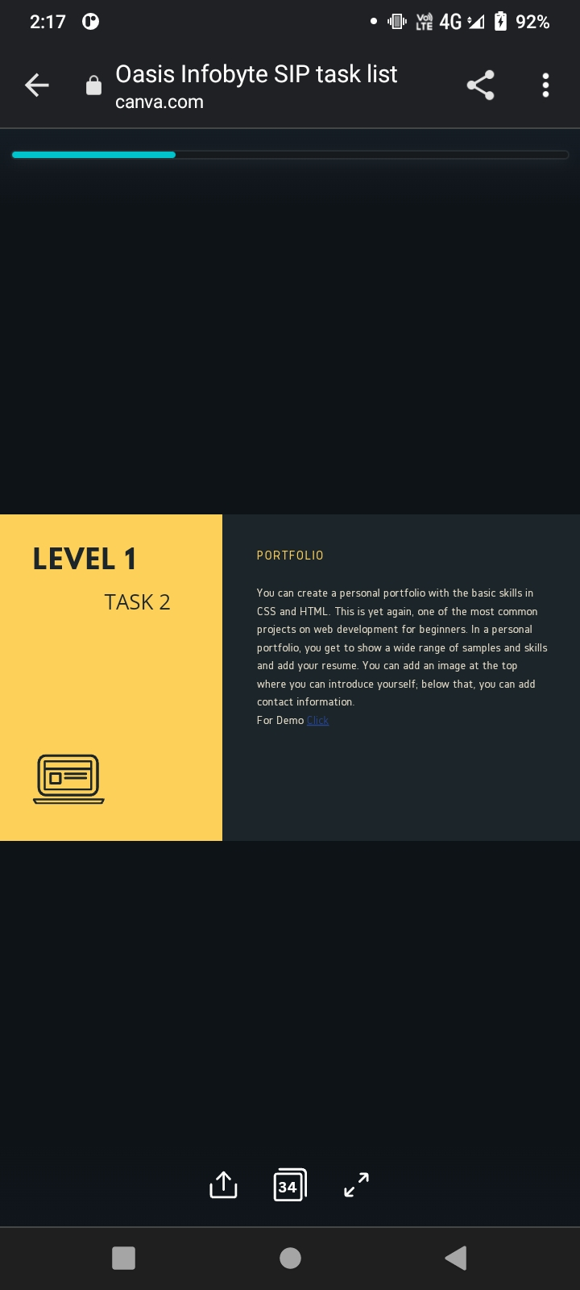

Slide 3


